Slide 1
Assignment #1: Needfinding
Team Alles Gut: Lucy Zhu, Zheng Lian, Xiaohai Liu, Cathy Wang

Slide 2
Introduction

Slide 3
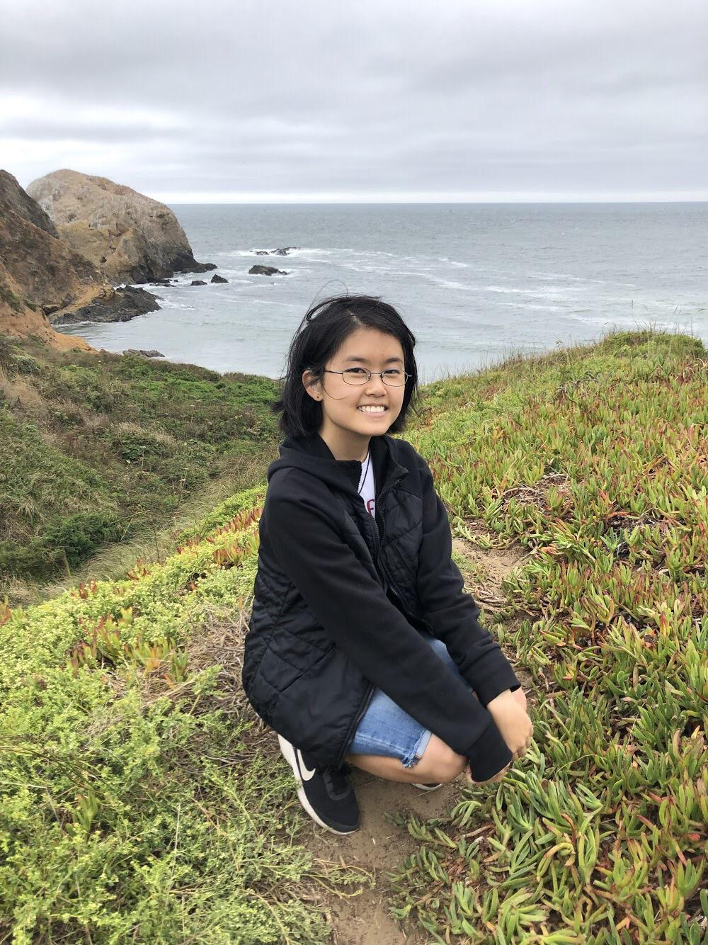
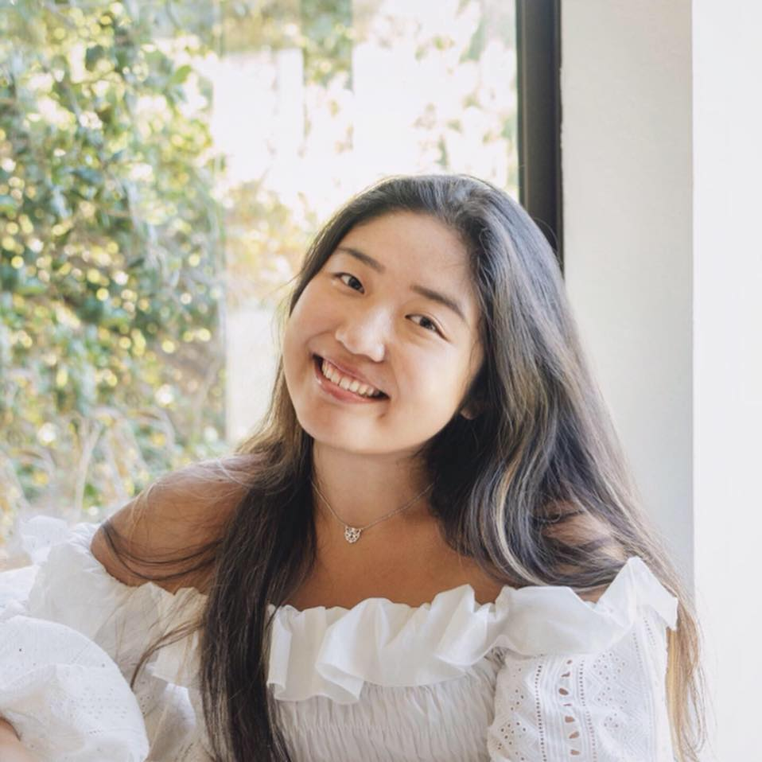
Zheng
xiaohai
Lucy
Cathy
Education
for social mobility

Slide 4
Needfinding methodology

Slide 5
5
17-25
3:2
People interviewed
Age range
Male to female ratio

Slide 6
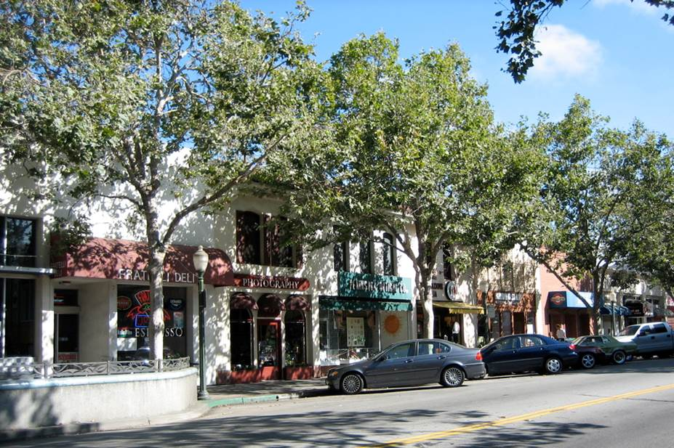
University Ave. Palo Alto
Notes:
People who we think might be looking for new industries, usually young, transitional stage of their life

Slide 7

How difficult is it to get jobs here?
What are your past occupations and work experiences?
Are you considering entering a new industry/job?
What was helpful in the past?
How? Why?...

Slide 8
Interview results

Slide 9
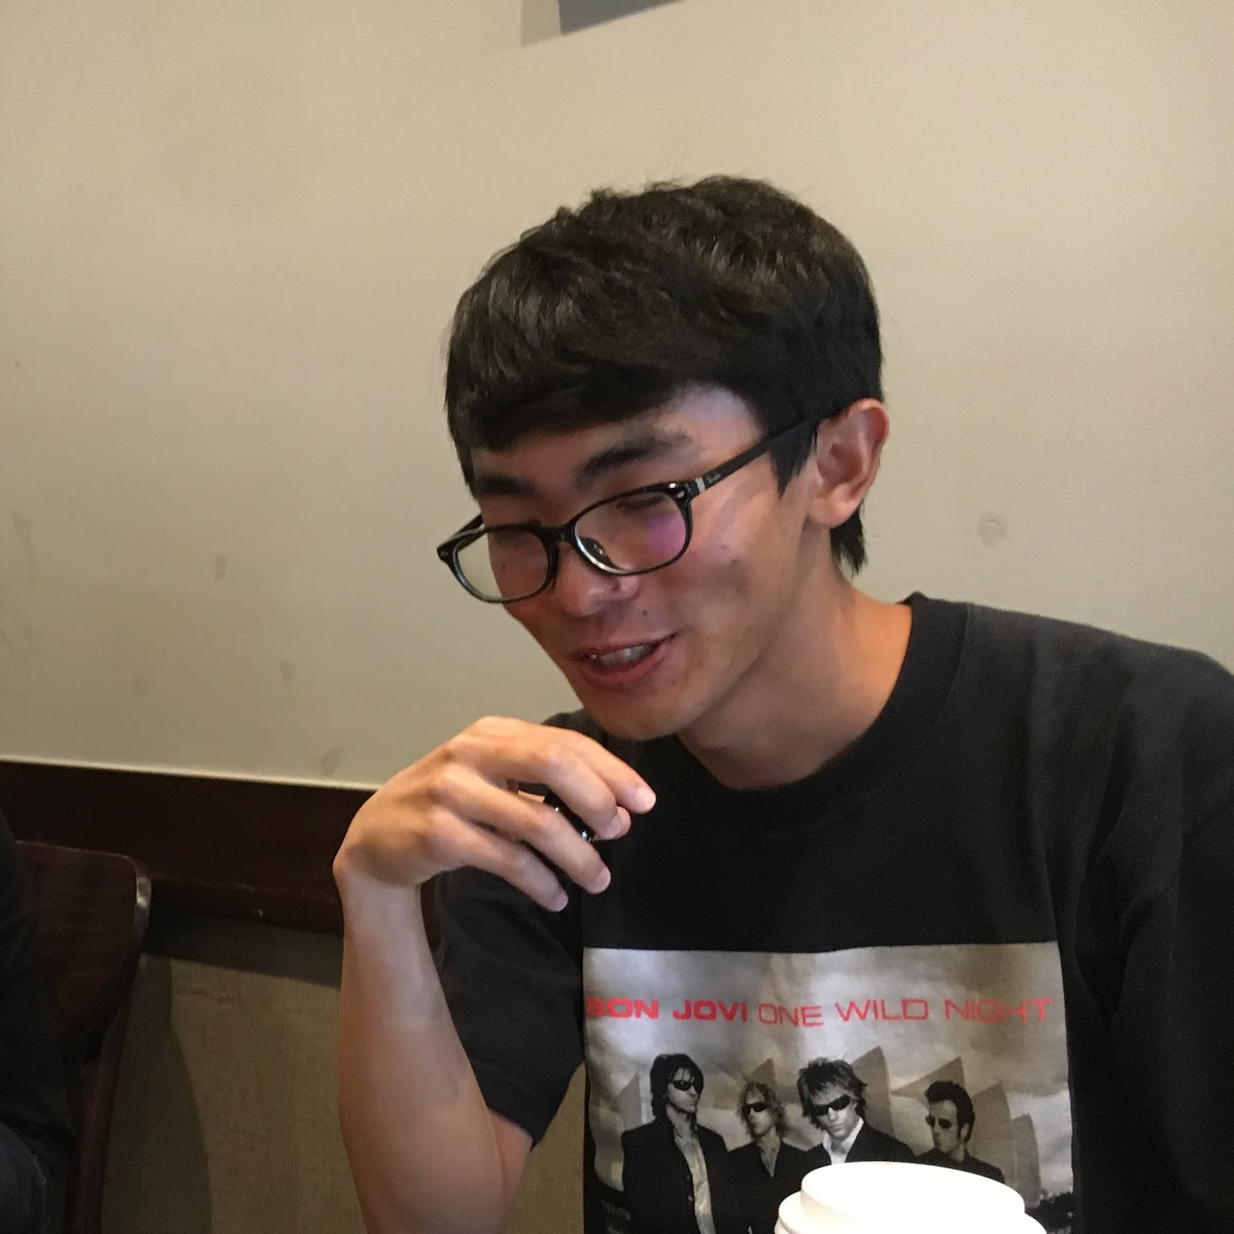
jinchen
24
Student
@Sofia University
“I am not a traditional student, nor an industry professional,
I am STUCK”
Notes:
Industry,
Explain quote

Slide 10
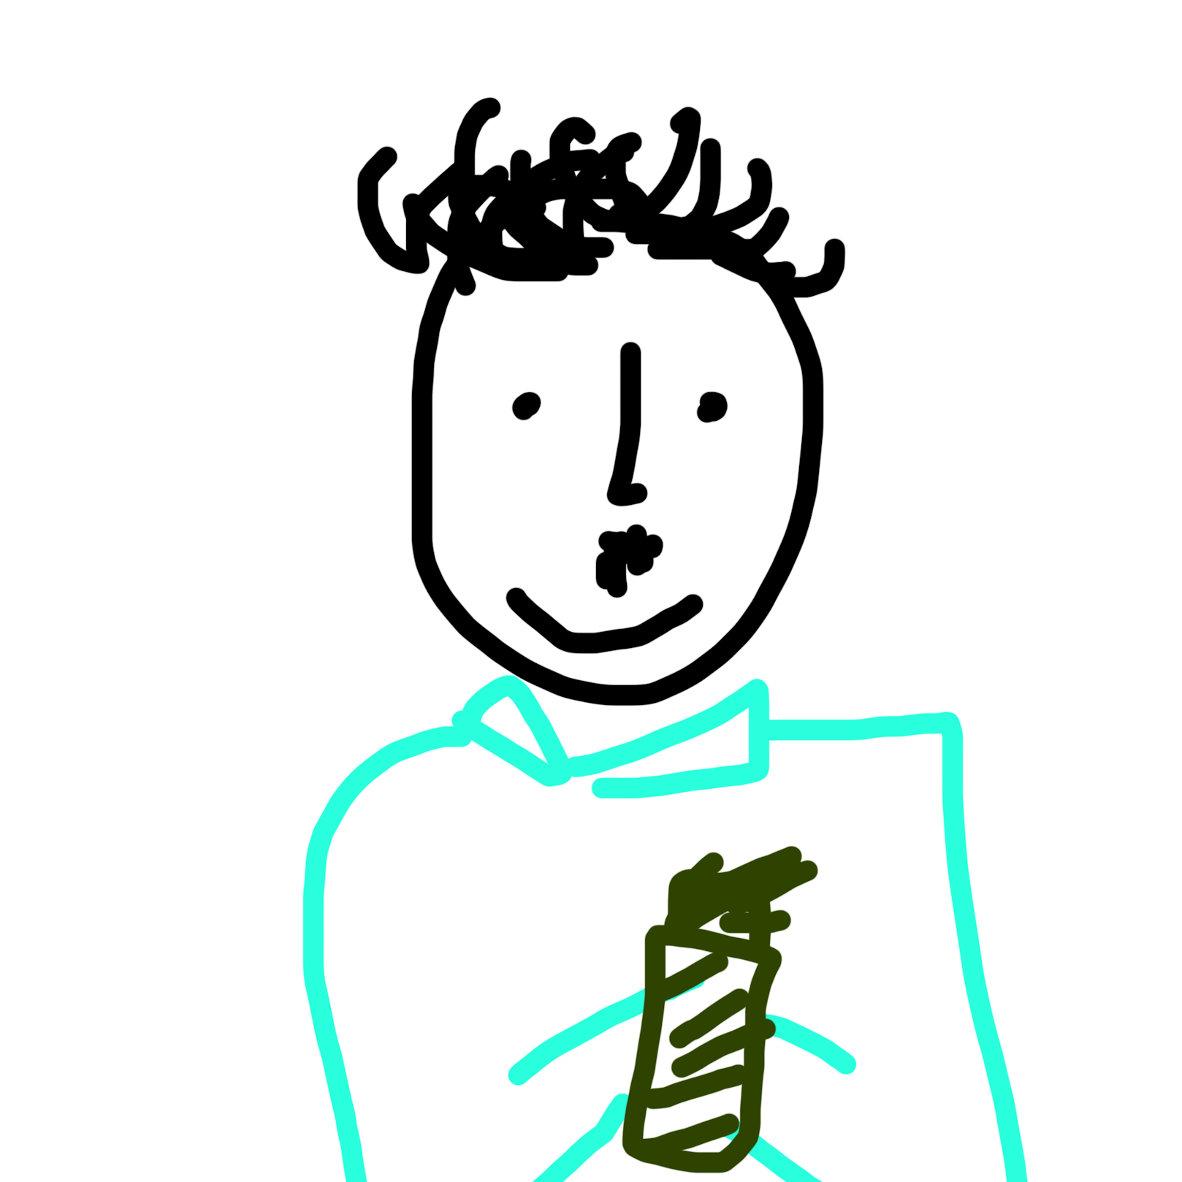
Sean
25
Skin Specialist
@Forever Flawless
“I love skin”

Slide 11
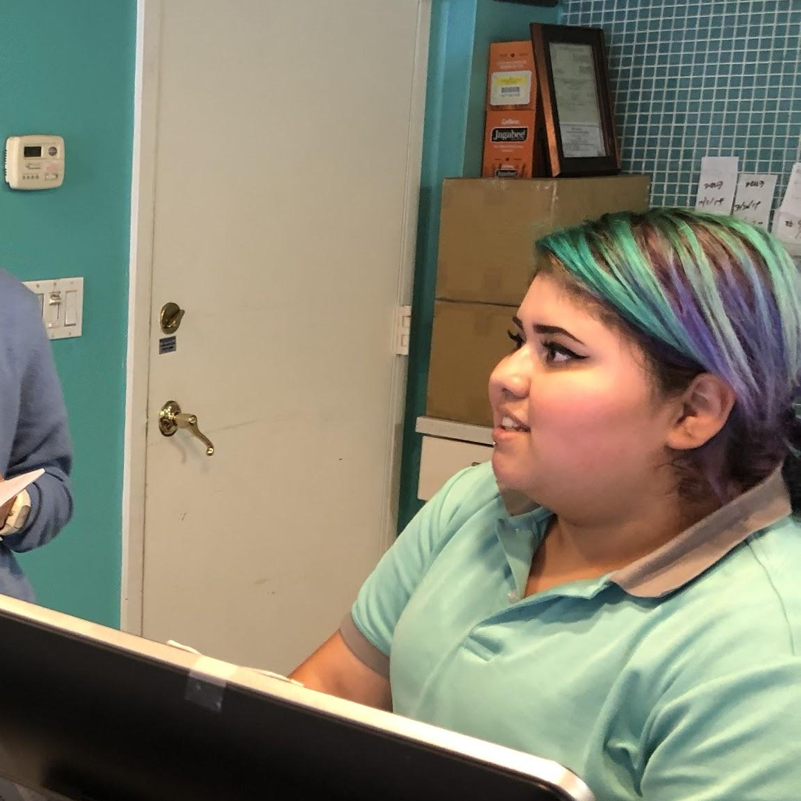
angie
18
Cashier
@T4
“My mother cannot support us financially as a single mom”

Slide 12
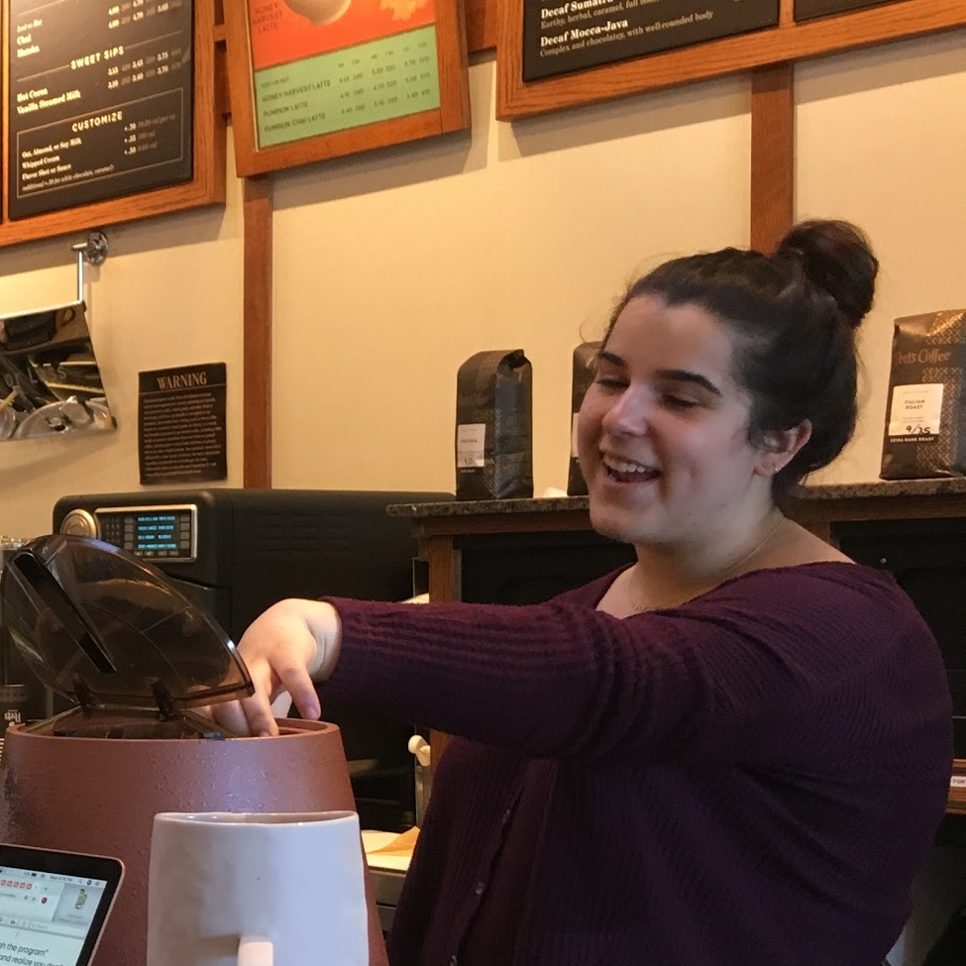
brooke
😉
17
Barista
@Peet’s Coffee
“I’ve been working since
I was 11”

Slide 13
jerry
21
Student
@Stanford University
“CS to fashion was an 180 degree turn for me”

Slide 14
Analysis

Slide 15
Angie
Say
Think
Grew up in an underfunded region
Forensic pathology(FP) feels intimidating
Supported by single mom
Dropped out of school
Job competition is an obstacle
Certified educational programs are helpful but scarce and out of reach
Gender discrimination could be an impediment in FP
Do
Feel
Frequent hand gestures to organize thoughts
Confident mannerism
Very candid about personal experience
Slight doubt about fitting into the field of FP
Intimidated
Stuck
Motivated

Slide 16
brooke
Say
Think
Trust people’s suggestions
Likes working, wants to feel independent
Started working since 11
Against taking an unenjoyable path
Personal experience has great value
Online resources are helpful career guidances
😉
Do
Feel
Guarded at first
Nervous chuckles at some phrases
Multitasking effortlessly
Stressed
Overwhelmed
Unsure
Serious

Slide 17
Jerry
Say
Think
“It all boils down to if you have the balls to talk to people”
“Only thing that stops you from doing things is yourself”
“Just had to convince people to bet on me and watch them do it”
He is equipped to do fashion without formal training
Ability to get a job depends on your willingness to take the leap
Vision more important than technicality in the field of fashion
Do
Feel
Relaxed
Eyes looked away
Laid back and reflective
Sat back up in between, excited
Ballsy
Confident
Independent
Uncertain of future, but hopeful
Inspired

Slide 18
DIscoveries
Most think a sense of independence is important, but are grounded by financial constraints and influenced by people around them
All value exposures to professional experience and advice
Some fields require great professionalism, others are about connections and visions
Many people go to YouTube/videos rather than journals and articles
Professional training programs are usually not accessible, unaffordable, and/or too competitive

Slide 19
questions
How to pinpoint professional subdomains that require our attention?
How to bridge the gap between professional programs and the underprivileged population?
How do we make people feel confident and independent to pursue their career?
How do we lower the opportunity cost for people pivoting to a new career?

Slide 20
insights
Needs
Professional experience and advice are valuable
To meaningfully and effectively connect with industry professionals
People value social and financial independence
To pursue self-actualizing career pressure-free
People usually find themselves disconnected from certain fields of professions
To gain access to various fields of profession

Slide 21
summary

Slide 22
We focused on:
Connections with industry professionals
Pivot to a new industry with low opportunity cost
Foreseeable paths to career development

Slide 23
THANKS!
Any questions?

Slide 24
*Appendix*

Slide 25
Signed Consent Forms
Interview Question Guide
Interview Pictures
Interview Recording
Unabridged Interview Analysis

